Slide 1
Automation & Delegation with ScriptRunner
Your smart Command Center for PowerShell
Achim Wieser
02.12.2017
Notes:
Member of ScriptRunner development team
What is ScriptRunner?
Automation & Delegation Solution with PowerShell
Delegate tasks implemented in PowerShell to users, who does not have scripting skills
Started in 2013 with first prototype
ScriptRunner 2018 is 4th release

Slide 2
Our added value for YOU personally
Evaluate the ScriptRunner product
Invoke-WebRequest –uri https://appsphere.sharefile.com/d-s5710ef37de243f38
Start-Setup –Host ‘win2016server‘ –vm $true –feature ‘browser-apps‘
Run-ScriptRunner –User ‘5‘ –Version ‘Evaluation‘ –Period ‘30days‘
Get a full version for one year for free
Give-Feedback –To ‘ScriptRunnerTeam‘
Get-ScriptRunner –User ‘5‘ –Period ‘365days‘ –Payment ‘for free‘ –Version ‘full‘ –Option ‘NotForResale‘
Notes:
Why are we at the PowerShell Saturday
We want to make you curious about ScriptRunner
We want you as a PowerShell expert, as PowerShell enthusiast to evaluate ScriptRunner
Download SR from our ShareFile server
Tell us which features you are missing,
Tell us what you are thinking anbout the usability,
Do you see any security issues
Everyone, who gives us feedback will obtain a full versioned license for one year

Slide 3
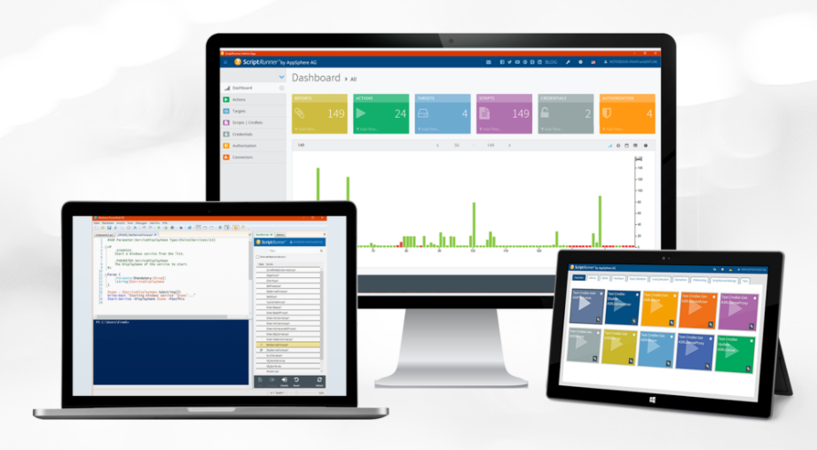
scriptrunner.com & scriptrunner.blog
#Your smart Command Center for PowerShell
$ScriptRunner = ‘leading all-in-one-solution’
function ScriptRunner
{
invoke-automation –fast
invoke-delegation –secure
invoke-control –activities
invoke-monitoring –execution
invoke-organize –policies
invoke-develop –scripts
}
write-output ‘solves problems where it hurts like hell’
Notes:
More details

Slide 4









ScriptRunner architecture & script policies
O365, Azure, others
PowerShell Script Policies
Target system(s)
Query (a set) of PARAM(s)
Start Execution of SCRIPT
on TARGETs or SERVICEs
Notifications
ScriptRunner Service Host
GIT, svn, TFS, …
with administ. CREDENTIAL
External system(s)
SQL
by an authorized USER
at click, point in time, event
ISE Add-On
Admin App
Delegate App

Slide 5
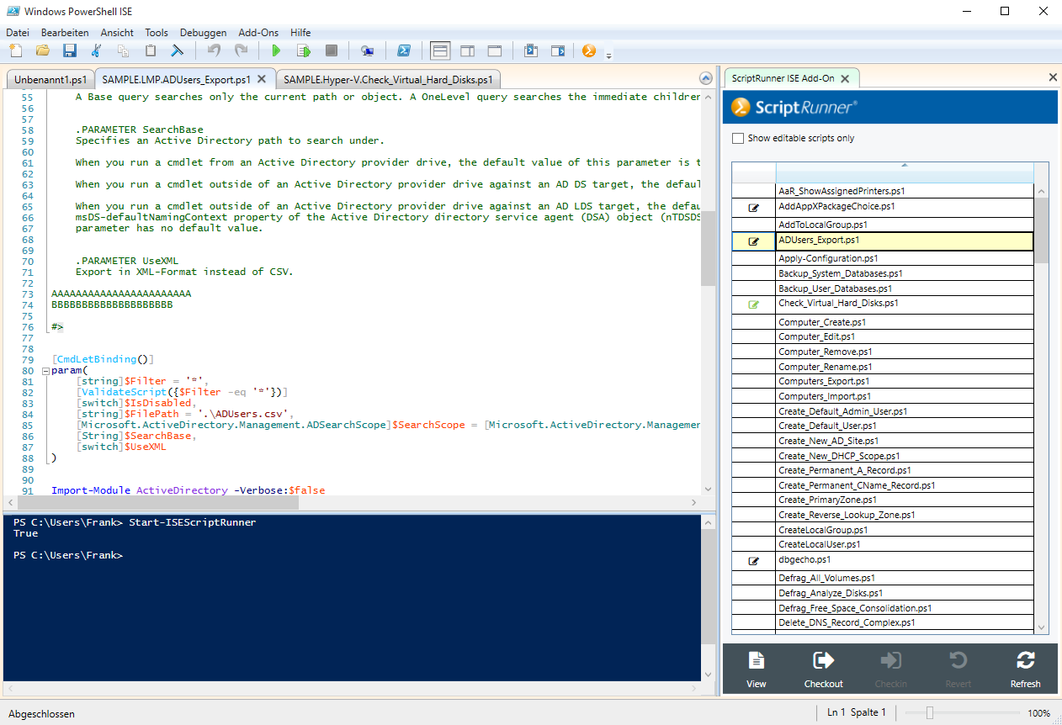
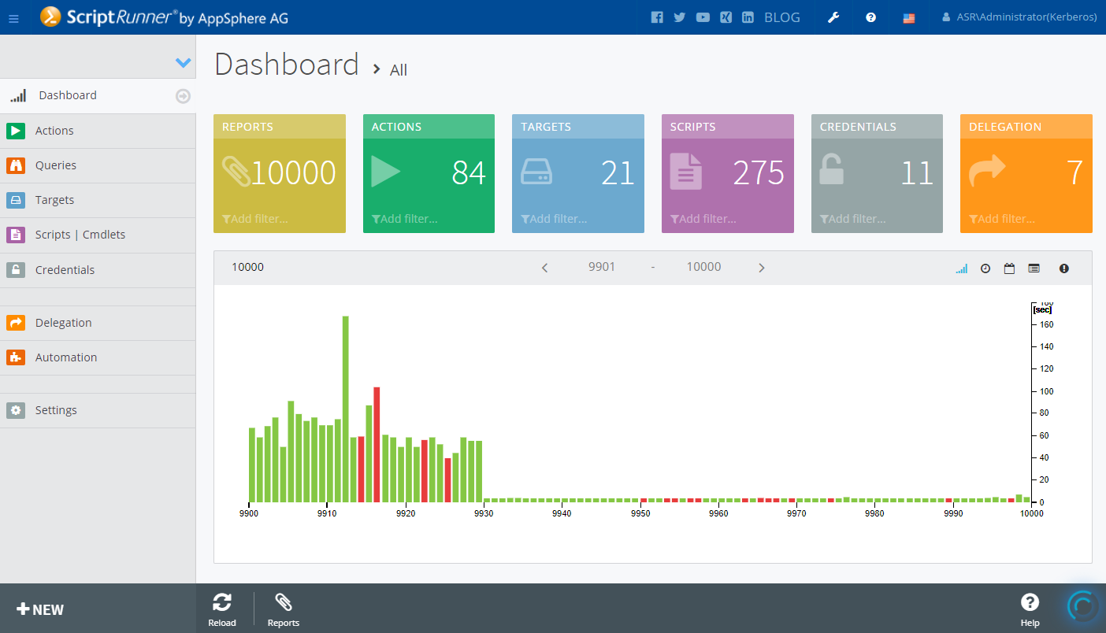
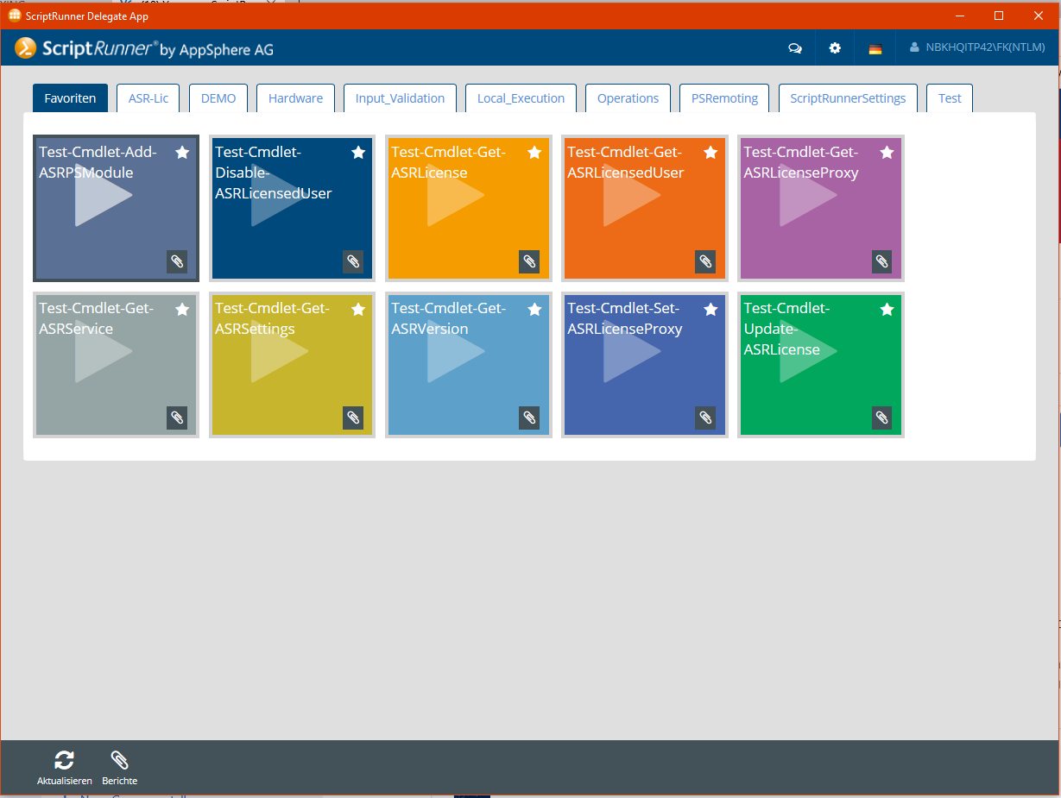
ScriptRunner Browser Apps
* IE11, Chrome, Firefox, Opera, Edge
PowerShell ISE Add-On
Admin App*
Delegate App*

Slide 6

Our vision about automation with PowerShell
DevOps
Admins
Service Desk
Self Service Portal, Intranet
User
Script
Development
Task Execution
Service
Delegation
Workflows & Service Management Systems
with ScriptRunner templates
Service Automation
Process
Event Automation
Application Automation
Monitoring automation
Automation & Delegation for PowerShell
other applications & services
Execution
complex IT systems landscape

Slide 7




























IT operating teams are enthusiastic about ScriptRunner
Notes:
Some of our customers

